Slide 1
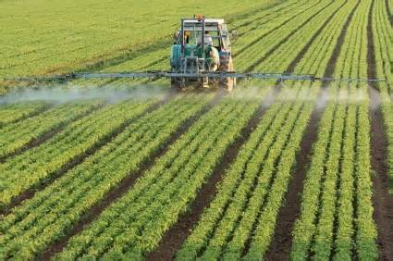
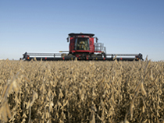
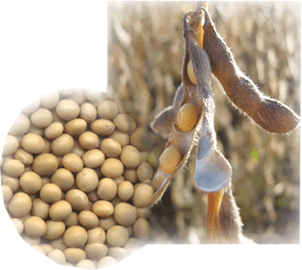
Quality of genetically modified soybeans – substantially equivalent to conventional and organic soybeans?
Thomas Bøhn PhD
Research Professor
GenØk - Centre for Biosafety, Tromsø, Norway
thomas@genok.org

Slide 2
What is the
“Substantial Equivalence Principle”?
Testing by the product owner
  Measurements of compositional elements
    Nutrients
      Amino acids
      Fatty acids
      Protein
      Carbohydrates
      Fibre
      Etc.

Slide 3

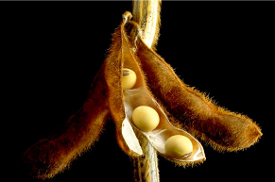
Important biosafety questions:
Are glyphosate-based herbicides toxic?
Can we find glyphosate residues in GM glyphosate tolerant soy?

Slide 4
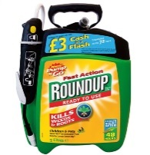
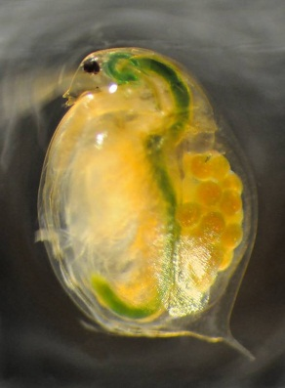
Research performed with the Daphnia model, part I
Toxicity of Roundup and glyphosate
  “The environmentally friendly herbicide”
  “Practically non-toxic”
  “A once in a century herbicide”
  750 different herbicide products
Daphnia magna
Glyphosate in feed (mg/kg)

Slide 5
Glyphosate in feed (mg/kg)

Slide 6
Acute Toxicity of glyphosate on
Daphnia magna
1000
930 mg/litre
LC₅₀ 48 hour
500
100
10
Early Monsanto
studies for EPA
(McAllister and Forbis 1978)
Notes:
Sjekk skriv fra Marek – historikk i gly tox

Slide 7
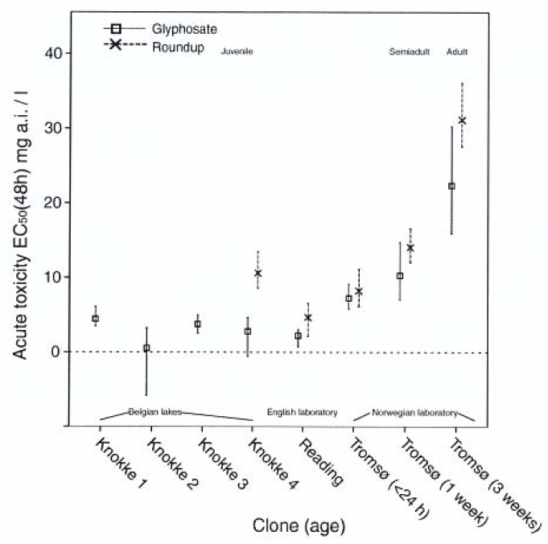
Acute toxicity revised
Glyphosate ~
100-300X
more toxic
From Cuhra et al. 2013 Ecotoxicology

Slide 8
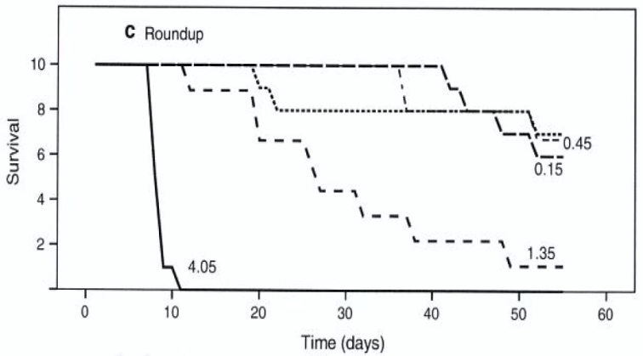
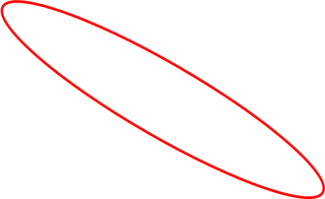
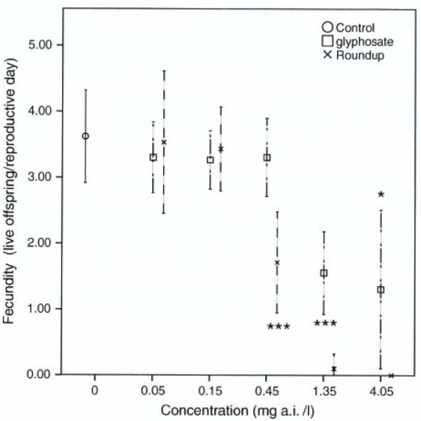
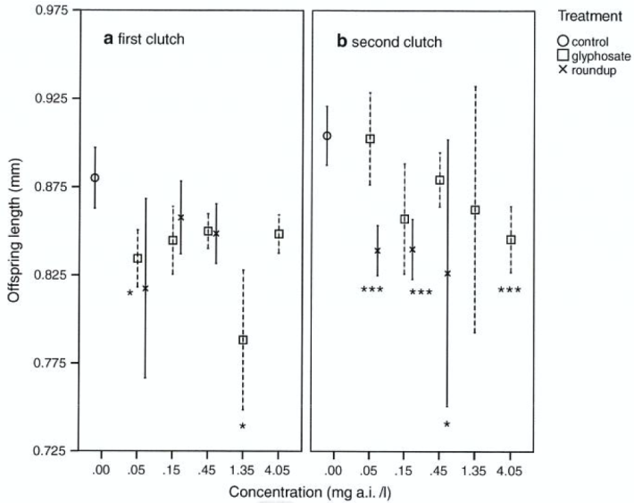
Chronic toxicity
Survival – 1.35 mg/l
Significant effects below environmental concentrations accepted in the US (0.7 mg/l)
Reproduction
0.45 mg/l
Juv. body size
0.05 mg/l
From Cuhra et al. 2013 Ecotoxicology

Slide 9

Research performed with the Daphnia model, part II
“Roundup Ready”, Herbicide Tolerant GM soy
Glyphosate in feed (mg/kg)

Slide 10
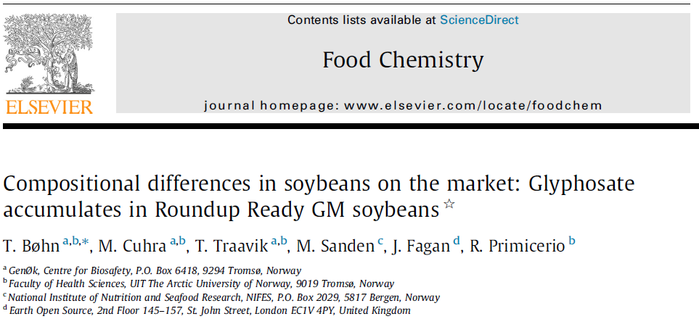

Slide 11
The global number 1 GM trait and plant
RR GM soy is dominating world soy production (81 %)
Sprayed with Roundup/glyphosate herbicides in the growing season
Notes:
Let us have a look at the most important plant and trait for GM plants: RR GM soy and Roundup herbicide

Slide 12
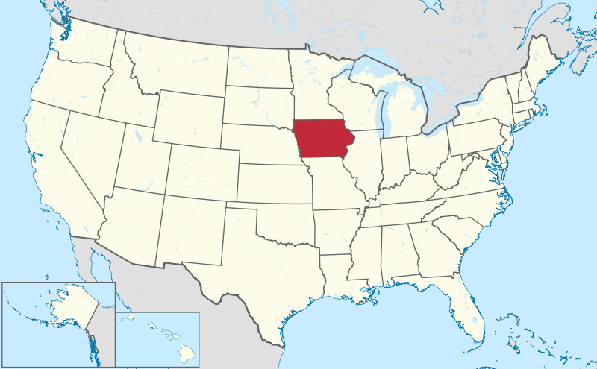
Soy material for testing
Iowa farmers
(n=31)
GM (n=10)
Conv. (n=10)
Organic (n=11)
Notes:
This triplet = 1 sample
7 samples X 3 main categories = 21 varieties for testing

Slide 13


Glyphosate and AMPA in soybeans
“Extreme levels and far higher than those typically found” (Monsanto 2011)
(below detection limit)
From Bøhn et al. 2014 Food Chemistry

Slide 14
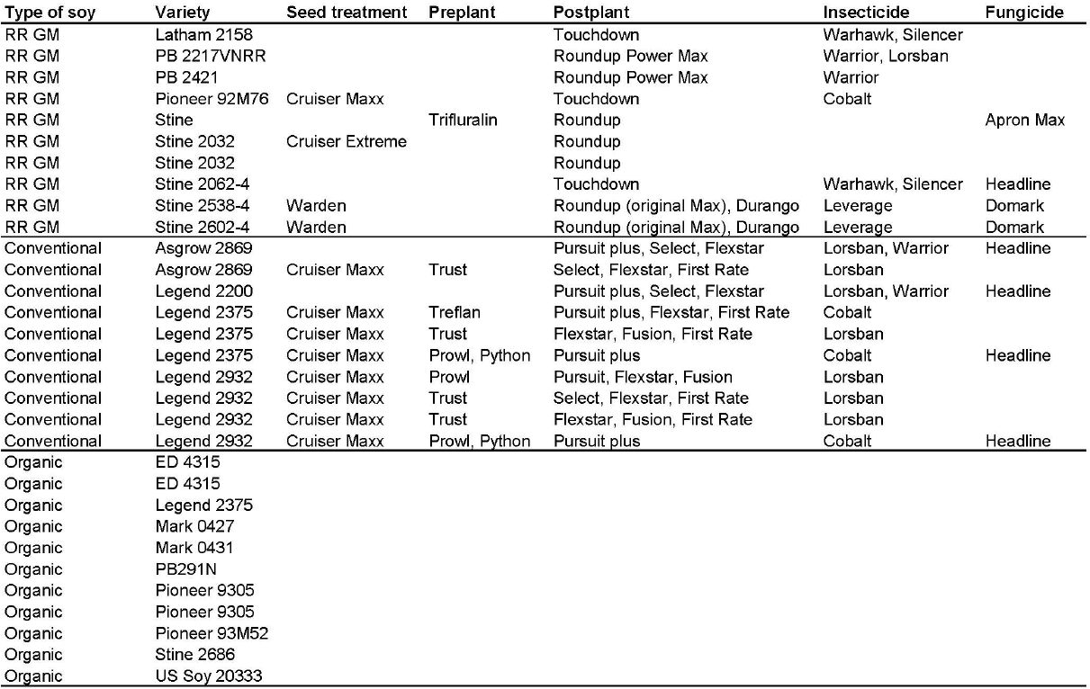
Herbicides used
(not allowed)
(Bøhn et al. 2014 Food Chemistry)

Slide 15
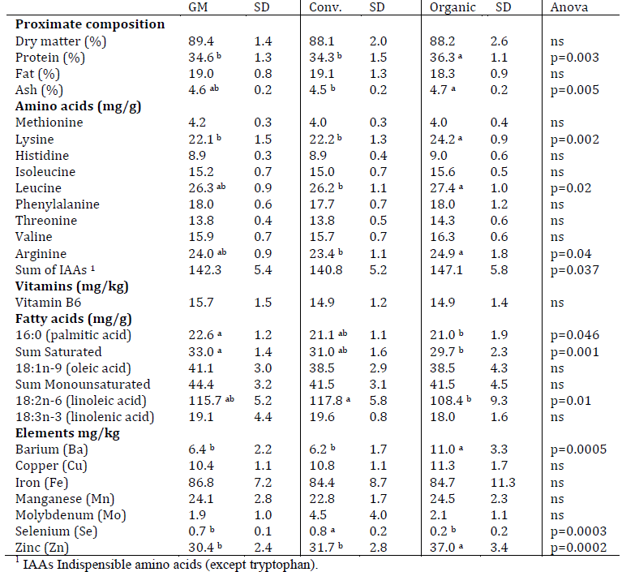
Elemental composition

Slide 16
Substantially different!
Discriminant analysis for GM, conventional and organic soy samples based on 35 variables (Glyphosate/AMPA residues are not included)
From Bøhn et al. 2014 Food Chemistry

Slide 17

Negative effects in food?
In Daphnia magna model
  0.05 – 1.35 mg/L of glyphosate give negative effects
In food and feed
  9.0 mg/kg of glyphosate residues in GM soybeans on the market

Slide 18

Feeding experiments in Daphnia:
Organic soy superior
(From Bøhn et al. 2016)

Slide 19
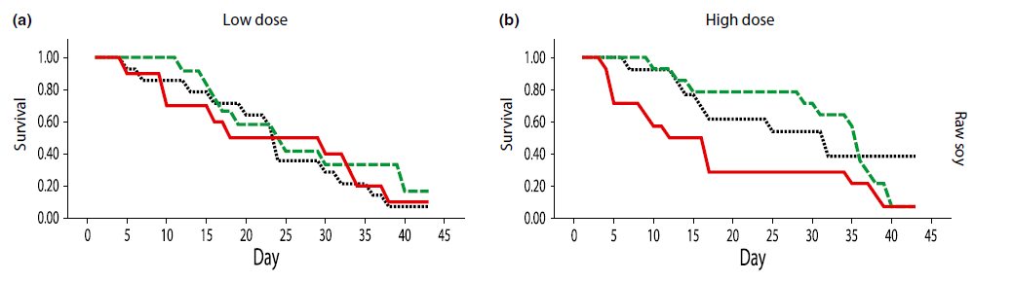
Differences in survival
(raw soy)
--- Organic
--- Conv.
--- Organic
--- GM
--- Conv.
--- GM
From Cuhra et al. 2014 Aquaculture Nutrition

Slide 20
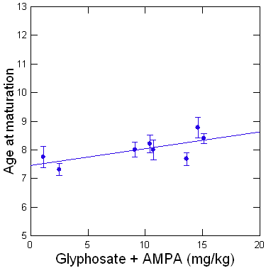
More glyphosate in soybeans
– delayed reproduction
R² = 5.3%
P = 0.005
(Cuhra et al. 2015)

Slide 21
High glyphosate in soybeans
– reduced life span
**
P<0.01
Expected longevity (days)
Low
Medium
High
Gly + Ampa (mg/kg)
(Cuhra et al. 2015)

Slide 22
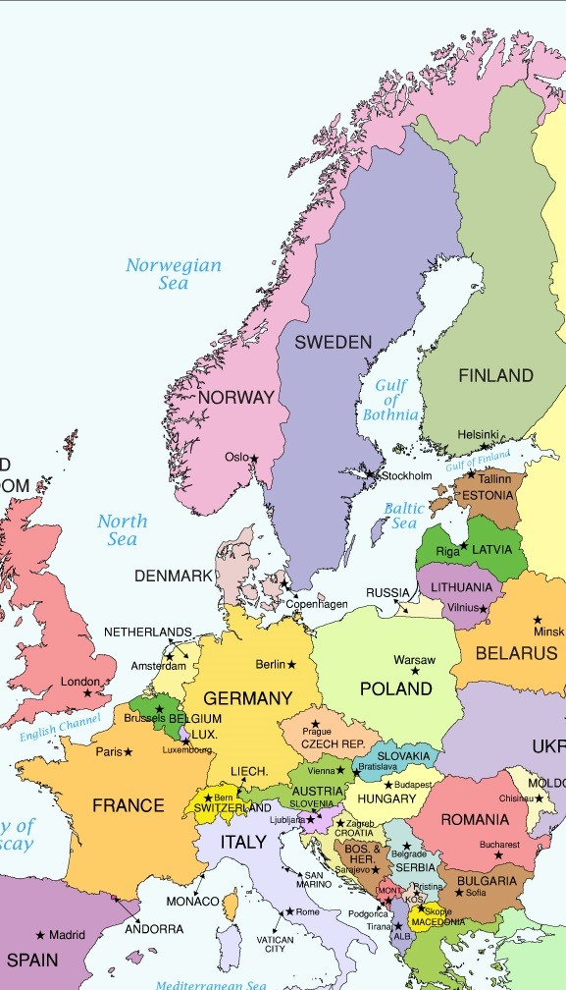
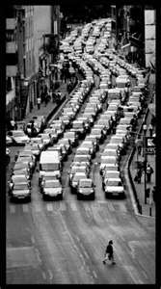
How much glyphosate is used globally?
About 1 mill tonnes produced / year
Equals about 1 mill cars
…i.e. a quadruple cue along Norway
Notes:
En tredjedel av alle registrerte biler i norge 2010
100 biler = 1 km
100 000 biler = 1000 km
1 000 000 biler = 10 000 km
Fire I bredden = 2500 km

Slide 23
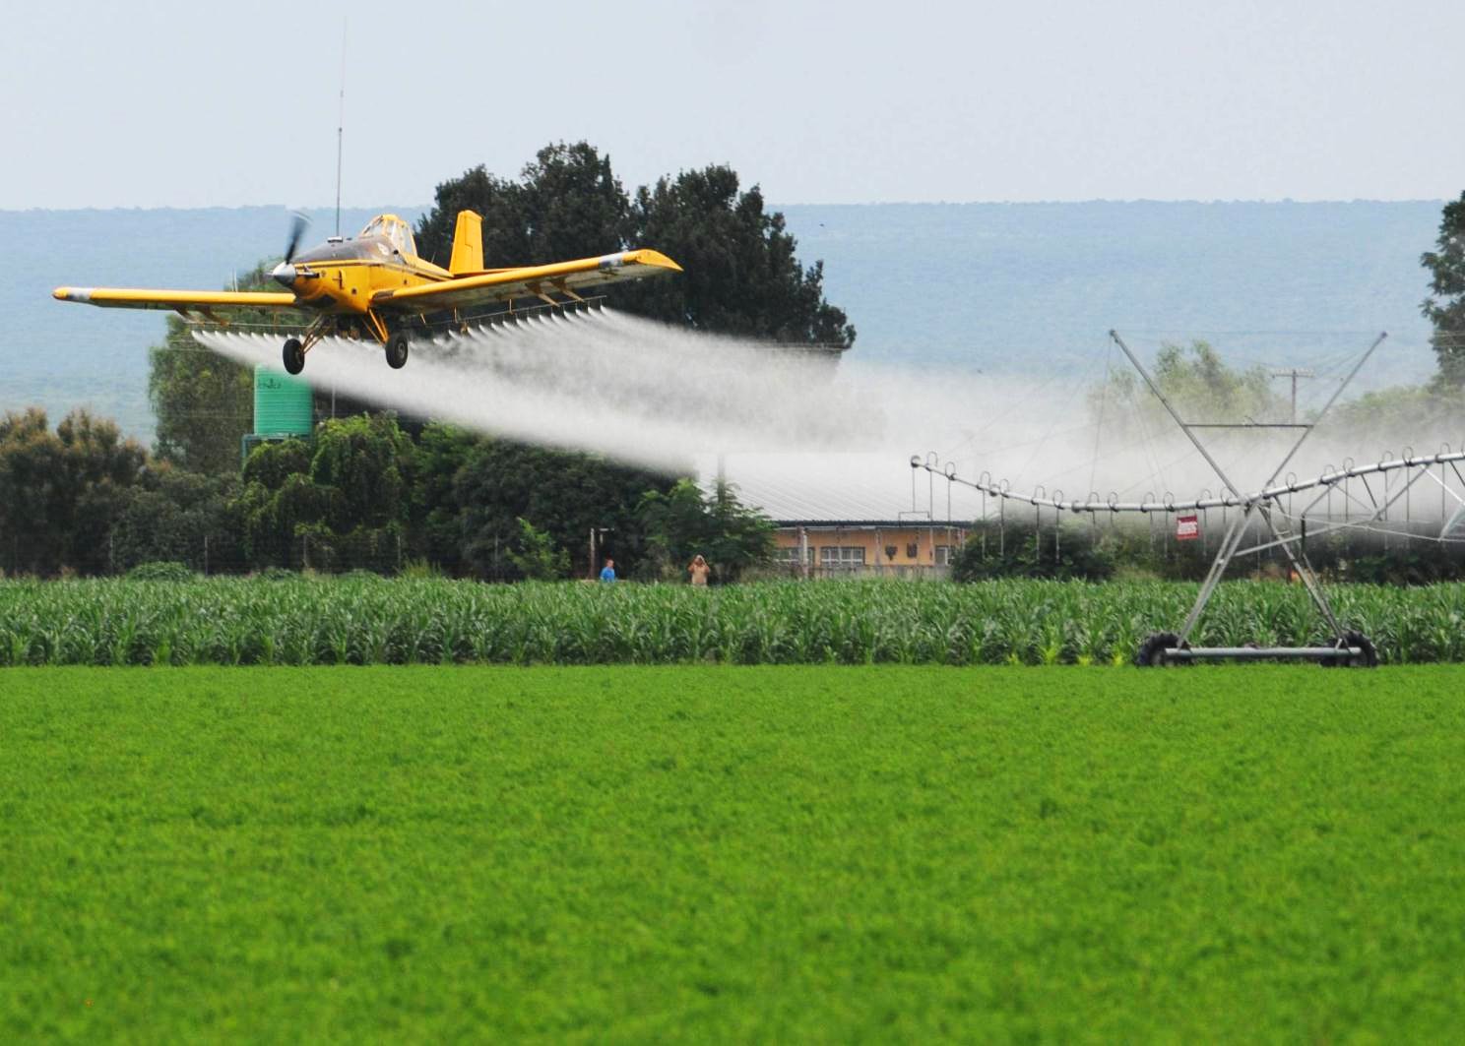
Fate of glyphosate
Exposed to glyphosate:
Weeds
Non-target organisms
Terrestrial, soil, aquatic ecosystems
HT GM crops

Slide 24
How much glyphosate in food/feed?
225 mill tonnes of HT GM soy produced
Residues of 9 mg/kg glyphosate (Bøhn et al. 2014)
In sum: approx. 2000 tonnes of glyphosate in food and feed from HT GM soy
Notes:
En tredjedel av alle registrerte biler i norge 2010
100 biler = 1 km
100 000 biler = 1000 km
1 000 000 biler = 10 000 km

Slide 26
Recent research on glyphosate
New classification from WHO / IARC 2015:
«Glyphosate is probably carcinogenic to humans»
(From Fritschi et al. 2015 Lancet Oncology)

Slide 27
The ‘Glyphosate Paradox’
From bio-degradable to non-degradable
From «practically non-toxic» to significant toxicity
From low volume use to 1 mill tonnes/year
Response from Regulation level: Increasing Residue Levels accepted in food and feed!
  In GM soy 0.1 ppm (1999), to 10, 20, 40 (2014) ppm…

Slide 28
Conclusions
Substantal equivalence is a superficial and crude first characterization of plant quality
It misses key elements like herbicide/pesticide residues
Herbicide tolerant GM crops:
  Leads to increased use of herbicides, due to resistance evolution in weeds
  GM plants accumulate herbicides, into food and feed products
Organic soy quality superior in Daphnia magna feeding tests
HT GM soy inferior as feed compared to organic and conventional soy
Proof of concept that high levels of herbicide residues in soy reduces feed quality

Slide 29
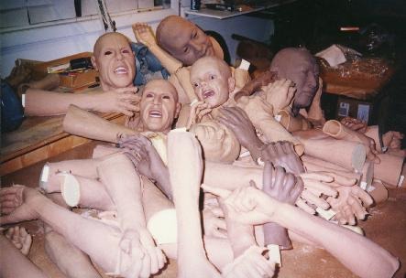

Thank you for your attention!
As you can see:
This pile is substantially equivalent to six people

